Slide 1
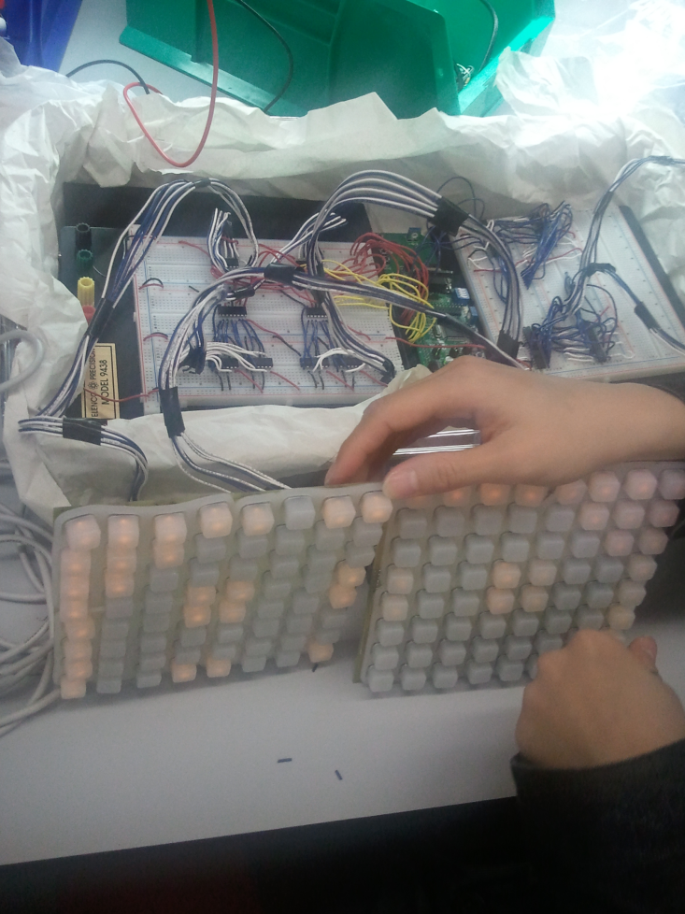
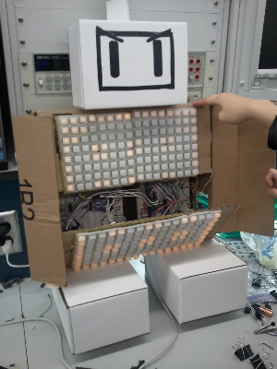
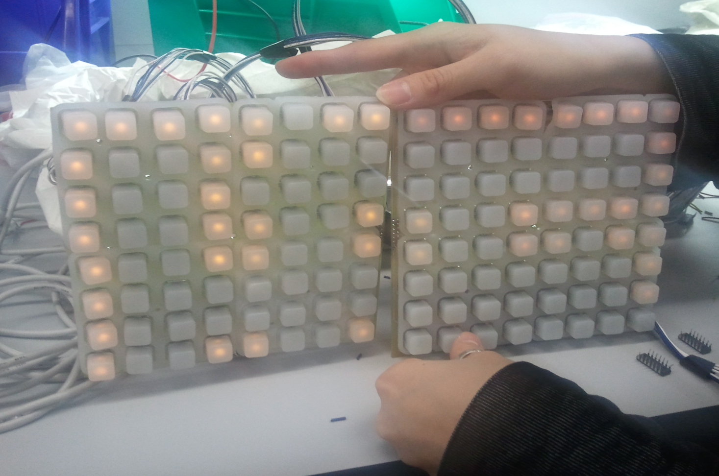
Bombernome
ESE519: Faqin Zhong, Monica Lui, Philip Peng

Slide 2
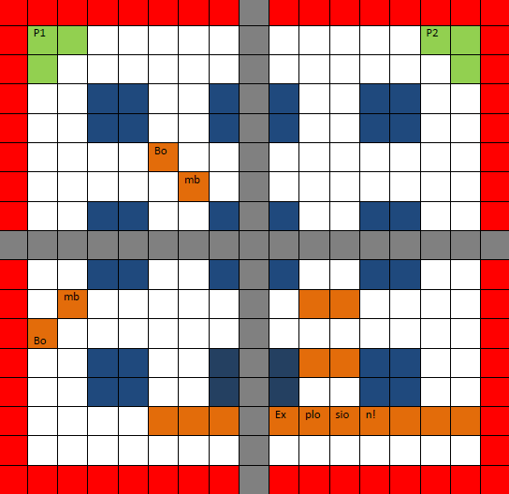
Bomberman x Monome
Motivation:
Make an interactive game using accelerometer and wireless communication with a simple display

Slide 3
Architecture
HC12 as game processor
FireFly as controllers for wireless communication
B-Mac
FireFly as receiver for game processor
B-Mac
GPIO
4 8x8 Monome Boards as display
Coded in C

Slide 4
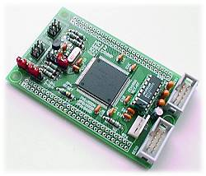
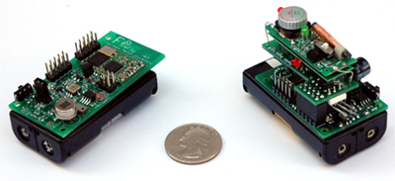
Hardware
Equipment:
9s12c128 Board
HC12 Debugger Board
4 8x8-Monome Boards
8 74F138 3-to-8 Decoders
8 SN74LS02N 2-Input Nor Gates
3 FireFly Nodes
3 Buzzers

Slide 5
Software
Connections:
Player Firefly read x, y, button values
Sends input to Master Firefly via bmac
Master Firefly toggles pins connected to HCS12
HCS12 polls input pins, updates on timer interrupt
HCS12 calculates output ports values per Monome
HCS12 lights up each of the 4 Monomes independently

Slide 6
Software
Game logic:
Splash screen, BOMB to start
Read latest player actions
Updates game state and game grid
Update lit led list, update Monome display
If any players caught in bomb, buzzer, splash
Profit???

Slide 7
Software
Actions:
2 players, up/down/left/right/bomb
3 bombs per, set->run away->explode->win!
Timings
Firefly bmac sensors & tx_task = ~40ms
Firefly bmac rx_task & pin toggle = ~30ms
HCS12 input poll = ~33ms
HCS12 game update = ~330ms (every 9 polls)

Slide 8
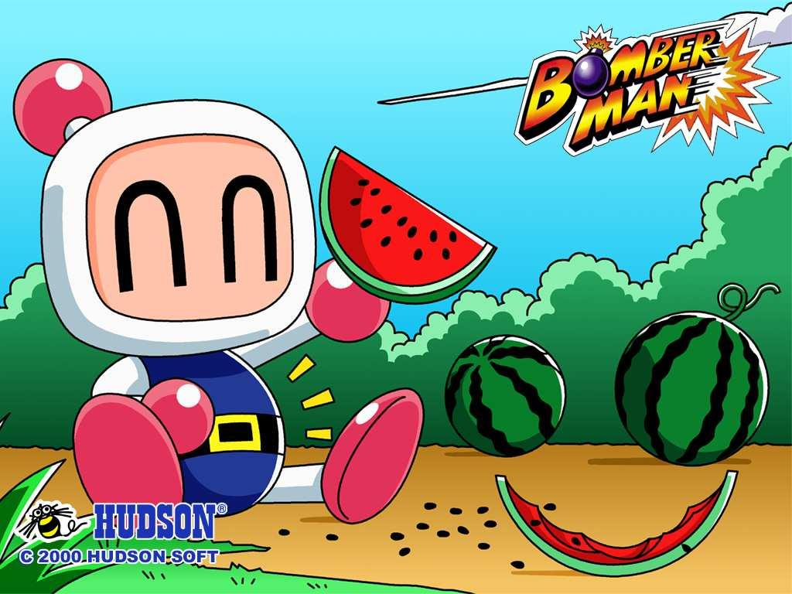
What Do We Have?
2-Player Bomberman clone!

