Slide 1

Please be seated and wait for the panel to start

Slide 2
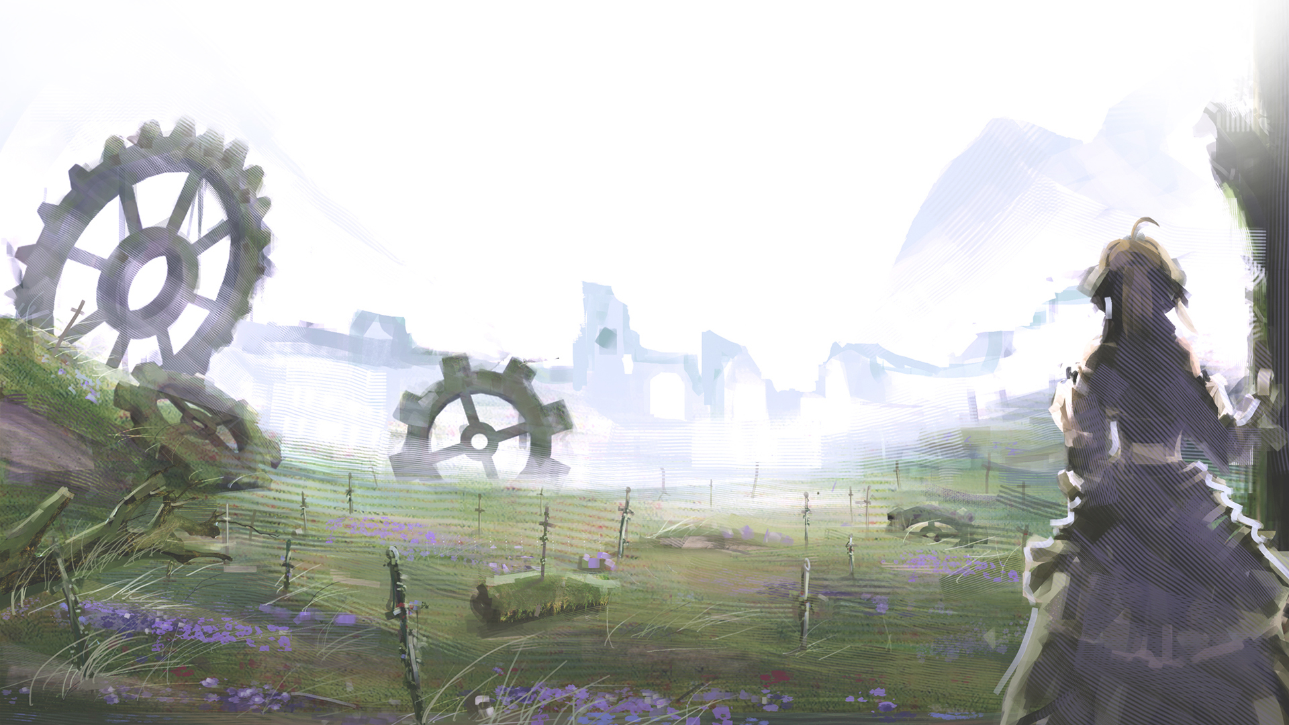
UNLIMITED TYPE-MOON WORKS
Sakura-con 2015
Presented by Keripo
Notes:
Welcome all to the Unlimited TYPE-MOON Works panel at Sakura-con 2015
My name is Keripo and I will be your panelist for tonight
The video that you just saw was the opening video for TYPE-MOON Fes, an event hosted by TYPE-MOON in 2012 to celebrate their 10th anniversary
Now before we get started, by show hands, how many of you recognize at least 1 series in that video
2-3? 4 or more? All of them?
Hopefully, by end of this panel, you will be recognize or at least heard of all of them
Now, before we start, I want to point out that because this is meant to be a heavily informative panel
Some of my slides will contain pieces of information such as release dates and various other details that I won’t be explicitly pointing out.
I will be posting these slides online on my website later though along with a full audio recording so don’t worry if you miss anything.

Slide 3

This Is (Not) A Rant
This panel will NOT cover:
  Saber’s true identity
  Why Arcueid is mai waifu
  Holy Grail War, Mana Transfer, etc.
  A meme is fine too
Notes:
Alright, lets get started. So lets start off with the question, what is this panel about?
When I start working on these slides a while back, I realized that what I had originally planned was so much that the panel would just turn into a long-winded, mindless rant
So, for the sake of you, the audience, I restructured this panel to be one friendly to and aimed for those new to TYPE-MOON fandom.
As a result, this panel NOT cover any of the following:
Spoilers for any of the series, such as Saber’s true identity
Detailed profiles of each series’ main characters, so unfortunately no, you will not hear me rant about why Arcueid is my waifu
In depth mechanics of Nasuverse, such as the inner workings of the Holy Grail War, the graphic details of the process of Mana transfers, etc.
And this panel will not, regrettably, cover the huge list of memes from the TYPE-MOON fandom, though I may sneak some in here and there
If wish to know more about any of these topics, however, you can come talk to me after the panel and I will try to gladly satisfy your curiosity

Slide 4

Unlimited Knowledge Works
This panel WILL feature:
  Brief history of TYPE-MOON
  List of TYPE-MOON works
  Videos, videos, and more videos!
Notes:
So what will this panel cover?
The panel will start off with a brief history lesson, aka TYPE-MOON History 101
The rest of the panel will then literally be Unlimited TYPE-MOON works, with me briefly introducing each series and their related medias
It is said that a picture is worth a 1000 words, and since we are at an anime convention and animes contain many thousand pictures, expect this panel to contain many videos

Slide 5
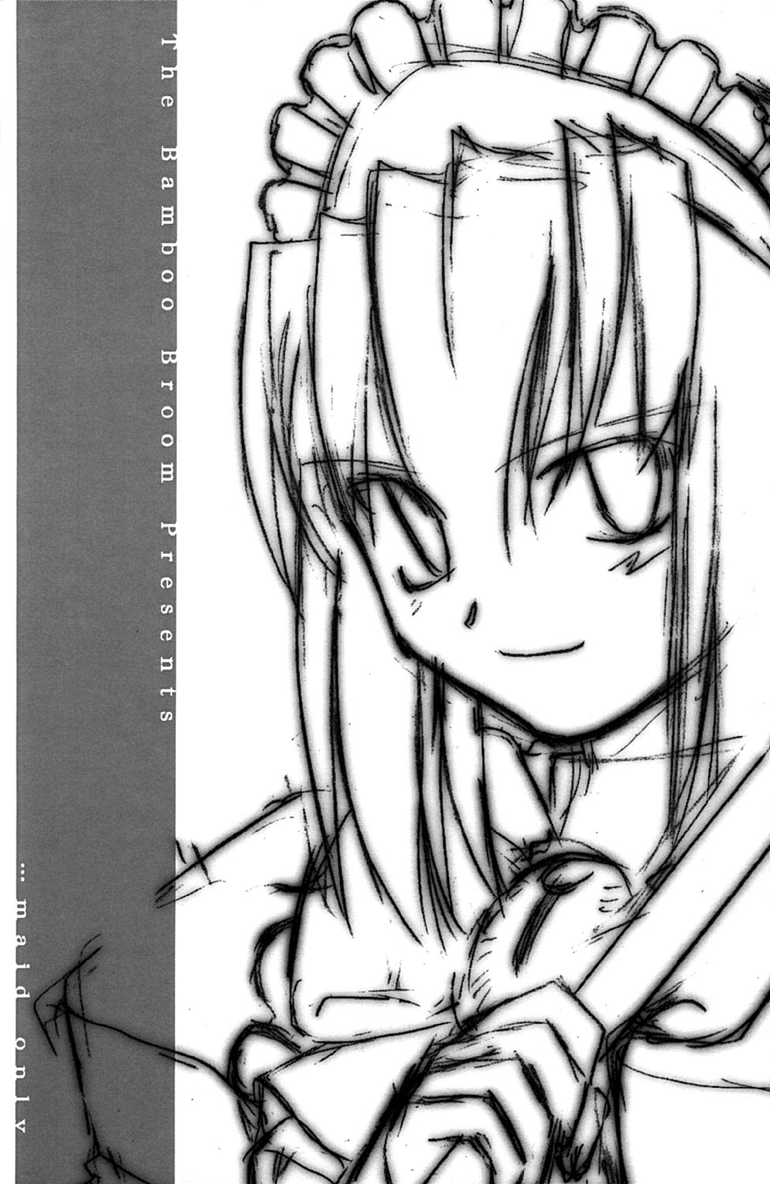
History of TYPE-MOON
Notes:
But before we get into those videos, lets briefly go over the history of TYPE-MOON

Slide 6




What is “TYPE-MOON”?
http://www.typemoon.com/
Japanese game company, 2002
Nasu Kinoko (奈須 きのこ) & Takeuchi Takashi (武内 崇)
Official name: Notes Co. Ltd
Notes:
What is “TYPE-MOON”
TYPE-MOON is a Japanese company most known for their games, and founded by Nasu & Takeuchi in 2002.
No one actually knows how Nasu and Takeuchi look like, but on the right are two self-protrait

Slide 7


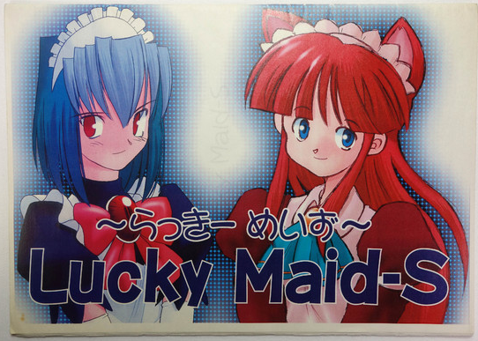
TYPE-MOON History 101
1990s: Early days
  Takeuchi & Nasu high-school buddies
  CoCiCaCe Club & Bamboo Broom
  Released various doujinshis & writings
Notes:
TYPE-MOON History 101
Our story starts in the early 1990s when Takeuchi & Nasu were old highschool buddies, with Takeuchi being an aspiring artist, and Nasu an amateur writer
The two were part of doujin circle CoCiCaCe Club, then later went on to form their own circle, Bamboo Broom
Under these two circle names, they released various doujinshis, some of which will easily fetch over $100 today due to their rarity despite their low quality

Slide 8
TYPE-MOON History 101
1999: TYPE-MOON
  Doujinshis did not make money
  Make an 18+ visual novel!
  Tsukihime = Great success!
Notes:
After graduating, Nasu & Takeuchi continued publishing doujinshis under the Bamboo Broom circle name, but it was soon clear that this did not cover living costs
So in 1999, they decided to try something else. And what in 1999 could make use of Nasu’s storytelling & Takeuchi’s art skills to make money? An 18+ visual novel of course!
And thus so was born Tsukihime, the first official work under the new “TYPE-MOON” circle name
And it was great success, establishing TYPE-MOON as a well-known circle in the doujin world

Slide 9
TYPE-MOON History 101
2003: Notes Co., Ltd
  Doujin circle too limiting
  Need $$$? Commercialize!
  Fate/stay night: It prints money!
  Allowed TYPE-MOON to go
  beyond an 18+VN company
Notes:
With the great success of Tsukihime, TYPE-MOON went on to start working on their next eroge
Having experienced the game creation process once, they recognized the financial limits of being a doujin circle and decided to go commercial
This eventually lead to the commercial publication of their next visual novel: Fate/stay night, which was a huge commercial success and brought in tons of profit
From there on, with their large pool of money, TYPE-MOON was able to move away from their 18+ visual novel roots and become the large Japanese game company we know today

Slide 10

TSUKIHIME
Notes:
- Now that history lesson is over lets start taking a look at the stuff TYPE-MOON has made, starting with their very first work, Tsukihime.
- Following is a PV for the Tsukihime remake announced at TYPE-MOON Fes, the same event whose opening video I showed at the beginning of this panel

Slide 11

Tsukihime (月姫)
18+ doujin visual novel
  1999 C56: Preview Edition
  1999 C57: Trial Edition
  2000 C58: Half Moon Edition
  2000 C59: Full Moon Edition
  2001 SC10: Tsukihime PLUS-DISC
  2001 C60: Kagetsu Tohya (歌月十夜)
  2003 CR33: Tsuki-Bako (月箱)
Story of Tohno Shiki, highschooler investigating series of murders in town
Notes:
Tsukihime first visual novel under TYPE-MOON brand, when TYPE-MOON was still an 18+ doujin circle
Tsukihime tells story of Tohno Shiki, a supposedly ordinary highschooler, who decides to investigate a series of mysterious murders happening in his town

Slide 12

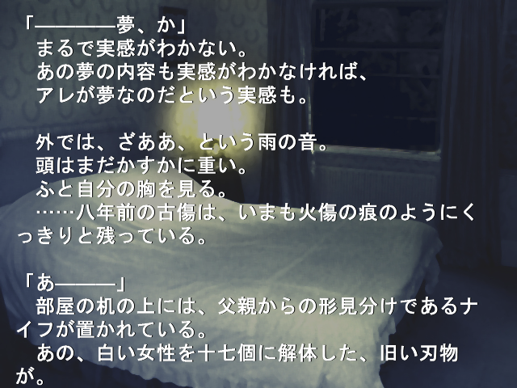


Tsukihime cont.
5 heroines
  Arcueid (vampire)
  Ciel (nun)
  Akiha (imouto)
  Hisui (maid #1)
  Kohaku (maid #2)
Still one of the best doujin games ever made
PLUS-DISC fandisk and Kagetsu Tohya sequel
Notes:
As a VN, gameplay consisted of reading text & making choices and featured 5 heroines, each with their own storylines
Now keep in mind, Tsuikihime was TYPE-MOON’s first attempt at creating a visual novel
So not only were Takeuchi’s artworks terrible, but Nasu would often wall-of-texted the player, such as in that last screenshot on the right
Despite this, Tsukihime was wildly popular and is still considered one of the best doujin games of its time, alongside 07th Expansion’s Higurashi visual novel series and ZUN’s Touhou Project danmaku games
Tsukihime was followed up the next year with a bonus disc, Tsukihime PLUS-DISC
And a year after that, a sequel, Kagetsu Tohya, was released featuring more stories 1 year after events of Tsukihime

Slide 13


Tsukihime Adaptations
2003: Shingetsutan Tsukihime (真月譚 月姫)
  Anime adaptation by J.C. Staff
  Poorly received: “There is no Tsukihime anime”
2008: Tsukihime remake announced
  2012: First PV video
  +new character designs!
Notes:
Tsukihime was also popular enough that JC Staff worked on anime adaptation, Shingetsutan Tsukihime (also known as Lunar Legend in English versions). The anime was unfortunately, pretty bad, with most fans, including myself, preferring to pretend it doesn’t exist. And even TYPE-MOON agrees as you may have noticed that no Tsukihime anime footage was included in that opening video.
What was included at TYPE-MOON Fes, however, was the PV you saw earlier of the Tsukihime remake, which will feature new character designs as well as a 6th heroine whose original route was previously cut due to lack of time, so look forward to that, cause I know I will

Slide 14
MELTY BLOOD
Notes:
In addition to the anime and manga series, TYPE-MOON also collaborated on a fighting game series called MELTY BLOOD
Here’s the PV for one of their arcade versions, MELTY BLOOD Act Cadenza Ver.B

Slide 15


MELTY BLOOD (メルティブラッド)
2D fighting game, collab with French Bread
  2002 C62: Trial Edition
  2002 CR32: Trial Edition 2
  2002 C63: MELTY BLOOD
  2003 C65: Re-ACT Trial Edition
  2004 May: Re-ACT
  2005 July: Re-ACT Final Tuned
Story of Tohno Shiki investigating new series of murders in neighbouring town
Notes:
MELTY BLOOD is a douijin 2D fighting game released for PC in 2002 and it continues story of Tohno Shiki one year after events of Kagetsu Tohya.
MELTY BLOOD was created in collaboration with doujin circle French Bread, which handled fighting game aspect while Nasu wrote the script and Takeuchi did the character designs and CG
This time, Shiki is investigating a new series of mysterious murders similar to those in Tsukihime, but happening in a neighbouring town

Slide 16
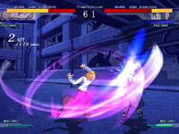

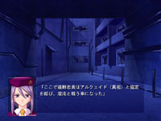
MELTY BLOOD cont.
6 playable characters, 8 more unlockable through story mode
Standard 2D fighting game
  Cancels, clashes, chain combos
  Magic Circuit system
  EX-Shielding
Expansion pack: Re-ACT
Notes:
Melty Blood start off with 6 playable characters but 8 more unlocked though story mode
Despite being a fighting game, MB had an extensive VN-like story mode since Nasu loved to write
As fighting game, it had pretty standard features for its time, borrowing many concepts from the Street Fighter and Guilty Gear series
What made Melty Blood stand out though, was it’s high production quality as a doujin game, with fluid controls and solid 60fps framerate
Soon after the release of Melty Blood, an expansion pack was made, titled MB Re-ACT. Re-ACT

Slide 17
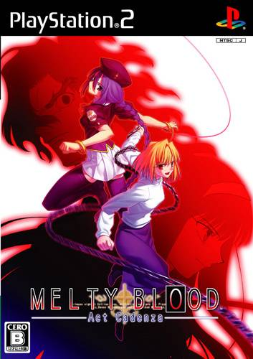
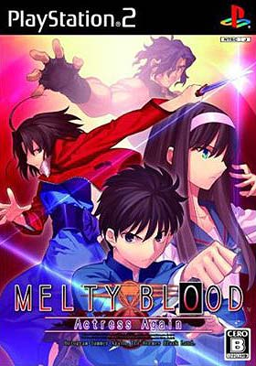
MELTY BLOOD cont.
MELTY BLOOD: Act Cadenza
  2005 Mar: Arcade version
  2006 Aug: PS2 version
  2007 July: PC version
MELTY BLOOD: Actress Again
  2008 Sept: Arcade version
  2009 Aug: PS2 version
  2010 July: Code Current Arcade version
  2011 Dec: Code Current PC version
Notes:
At same time, TYPE-MOON & French Bread working with Ecole Software on an arcade port, which was released as Melty Blood: Act Cadenza
Act Cadenza was a huge bump up from Re-ACT, mainly because, at this time, TYPE-MOON had commercialized and was receiving large amounts of income from their Fate VNs
But it didn’t stop there of course
TYPE-MOON and Ecole Software continued working on the third game of the series, Melty Blood: Actress Again
Like Re-ACT to Act Cadenza, Actress Again was also a drastic update to the game series and introduced new playable characters such as Ryougi Shiki from Kara no Kyoukai

Slide 18

KARA NO KYOUKAI
Notes:
Speaking of Kara no Kyoukai, here it is!
Most know Kara no Kyoukai for the movie series adaptation, so here is the trailer for one of them (4th one):
Please note that this trailer is a bit on the graphic side, so if you aren’t comfortable with seeing blood, you might want to close eyes for this one

Slide 19


Kara no Kyoukai (空の境界)
Light novel written by Nasu
  1998: Chptr 1-5 online blog
  1999 C56: Chptr 6-7
  2001 C61: Doujinshi version
  2004 Aug: Commercial version
  2008 C74: Chptr 8: Mirai Fukuin
Collection of seemingly independent stories featuring Ryougi Shiki, a trained assassin and detective assistant
Notes:
Kara no Kyoukai is an 7-chapter doujin light novel written by Nasu in his early days and is often considered his debut as a writer before he started working on Tsukihime
Unlike most light novels, KnK is told as a collection of seemingly independent stories, most of them relating to a murder mystery, that get investigated by Ryougi Shiki, a trained assassin working for a magical detective agency

Slide 20
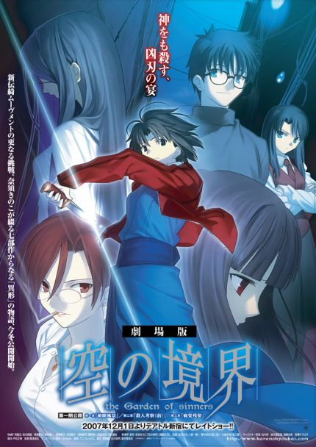
Kara no Kyoukai Films
Movie adaptation by ufotable
  2007 Dec: Overlooking View
  2007 Dec: A Study in Murder – Part 1
  2008 Jan: Remaining Sense of Pain
  2008 May: The Hollow Shrine
  2008 Aug: Paradox Spiral
  2008 Dec: Oblivion Recording
  2009 Mar: Gate of Seventh Heaven
  2009 Aug: A Study in Murder – Part 2
  2011 Feb: Epilogue (OVA)
  2013 Sept: Future Gospel + Extra Chorus
Extremely popular, ufotable’s rise to fame
Notes:
What most people know Kara no Kyoukai from is not the light novels, but the movie adaptations
In 2006, TYPE-MOON was approached by ufotable and a 7-part film series was announced, adapting the first 7-chapter into animated movie form
The result was a stunning series of movies released over the course of 2 years, topping the Japanese box offices and bringing ufotable’s name to fame in the anime industry

Slide 21
FATE/STAY NIGHT
Notes:
And now, we come to Fate/stay night, the series that made TYPE-MOON what they are today
The following is the Heaven’s Feel OP animation for the PS Vita version of the game, animated by ufotable

Slide 22
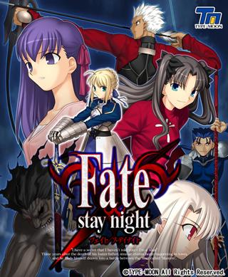
Fate/stay night
18+ commercial visual novel
  2003 Jan: Trial Edition
  2004 Jan: First Press Limited Edition
  2004 Mar: Regular Edition
  2006 Mar: DVD Edition
Story of Emiya Shirou, ordinary highschool student who is suddenly thrown into the Holy Grail War and forced to fight alongside his servant, Saber
Notes:
As mentioned earlier in the history 101, Fate/stay night was TYPE-MOON’s first commercial work, an 18+ visual novel for PC
The visual novel tells the story of Emiya Shirou, a university student who, due to a series of unfortunate events, is thrown into a magical battle royale called the Holy Grail War, and is forced to fight alongside his Servant Saber against 6 other Masters for the all-wish-granting device, the Holy Grail

Slide 23
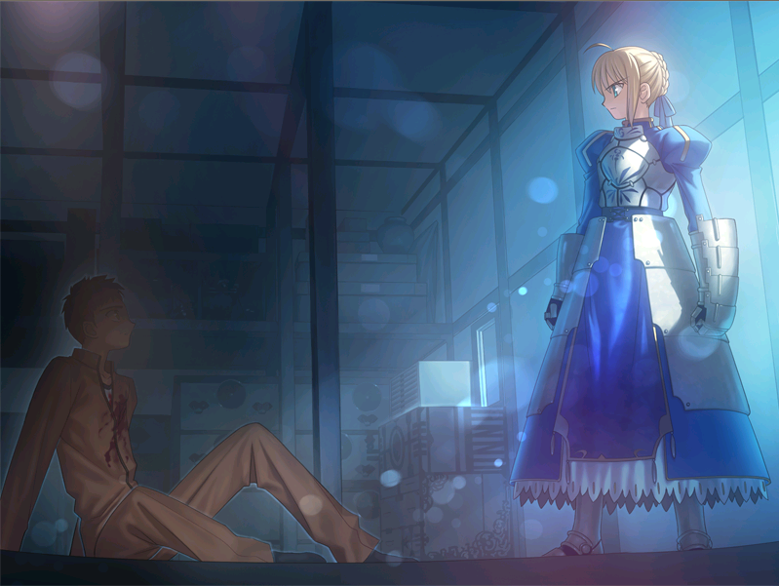
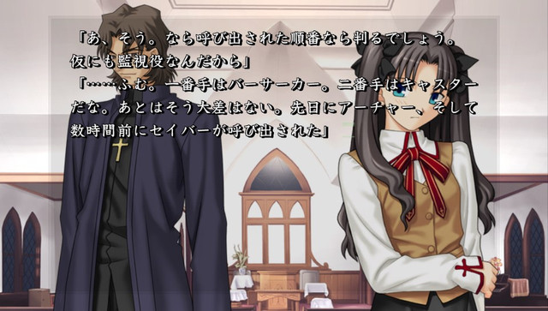
Fate/stay night cont.
3 routes:
  Fate: Saber (his Servant)
  Unlimited Blade Works: Tohsaka Rin (classmate)
  Heaven’s Feel: Matou Sakura (underclassman)
Higher quality production than Tsukihime
Extremely popular, bestseller
Notes:
Like Tsukihime, gameplay consisted of reading walls of text, and making choices, and occasionally seeing CG artwork, some of which were 18+
Fate/stay night features 3 main routes:
Fate route, also known as the route for Saber, Shirou’s Servant
Unlimited Blade Works, the route for Tohsaka Rin, his classmate and a powerful magician also participating in the Holy Grail War, and
Heaven’s Feel, the route for Matou Sakura, an underclassmen with a dark past
Since F/SN was produced as a commercial work, TYPE-MOON had a lot more budget as well as staffing than when they produced Tsukihime, resulting in a significantly higher quality work with noticeably improved graphics, soundtrack, as well as an upgraded game engine
This paid off, as Fate/stay night was extremely popular, selling over 150k units and topping visual novel charts

Slide 24
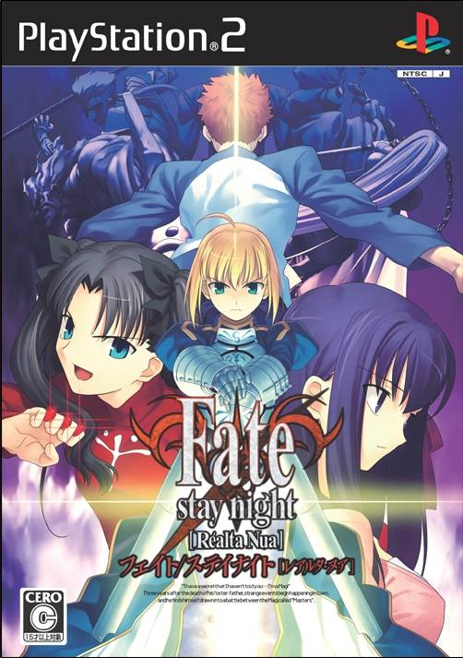
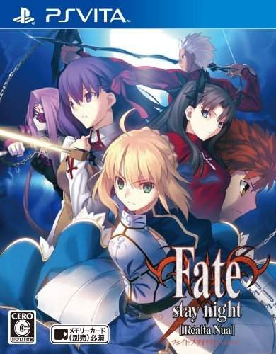
Fate/stay night [Realta Nua]
Non-adult version
  2007 Apr: PS2 version
  2011 Dec: PC version: Fate
  2012 Jan: PC version: UBW
  2012 Feb: PC version: Heaven’s Feel
  2014 Sept: PSVita version
Voice-overs and animated OP
Notes:
With the commercial success of Fate/stay night, TYPE-MOON quickly realized that they no longer needed to rely on 18+ H scenes to make money
So after they finished up with Melty Blood Act Cadenza, TYPE-MOON started releasing Fate/stay night [Realta Nua], a non-adult port for PS2, then later PC and PSVita

Slide 25


Fate/stay night Animes
Multiple anime adaptations!
2006: Fate (TV) by Studio Deen
2010: UBW (movie) by Studio Deen
2014: UBW (TV) by ufotable
2016?: Heaven’s Feel (movie) by ufotable
Notes:
Now you know your series has become really popular once it gets adapted into anime not just once, but multiple times
And such was the case with F/SN, which got it’s first 24-episode anime adaptation in 2006 by Studio Deen, loosely based on the Fate route
Unlike Tsukihime adaptation, Studio Deen’s adaptation was generally well received, leading to a movie adaptation of the UBW route in 2010
Following ufotable’s amazing work with Kara no Kyoukai and Fate/zero adaptations, a new F/SN TV anime adaptation of Unlimited Blade Works was started just last year and is still ongoing today
Ufotable also announced a movie adaptation of the Heaven’s Feel route which, although not officially confirmed yet, will most likely air sometime next year

Slide 26
FATE/HOLLOW ATARAXIA
Notes:
With the commercial success of Fate/stay night, TYPE-MOON went on directly to work on it’s sequel, Fate/hollow ataraxia
Here is ataraxia version OP animation for the PS Vita port of the game, also animated by ufotable

Slide 27


Fate/hollow ataraxia
18+ sequel to Fate/stay night
  2005 Oct: First Press Edition
  2005 Dec: Regular Edition
  2014 Jan: F/SN + F/HA Box Set
  2014 Nov: PSVita version
Multiple side stories and mini-games, based half a year after F/SN, with some new characters
Notes:
Like Kagetsu Tohya was to Tsukihime, F/HA was essentially a fandisc, containing multiple non-canon side stories set half a year after Fate/stay night
Like with F/SN, F/HA eventually got the Realta Nua treatment, with a non-adult PSVita port released in 2014 with voice-overs and animated OPs by ufotable, one of which you saw earlier

Slide 28
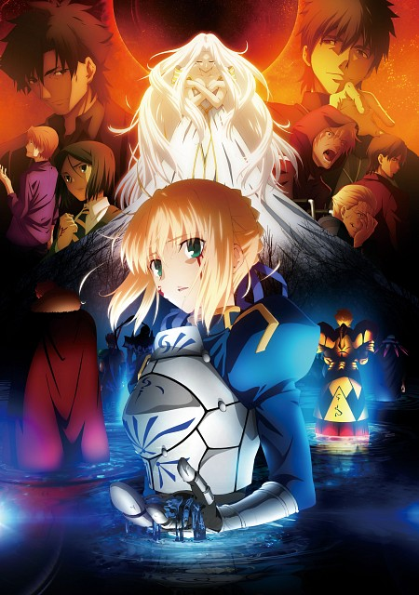
FATE/ZERO
Notes:
Now that we have the sequel of Fate/stay night, what about a prequel? Enter Fate/zero?
For both F/SN and F/HA, I chose videos that most people probably haven’t seen, but for F/Z, there’s only the anime adaptation, so here it is, once again, by ufotable

Slide 29

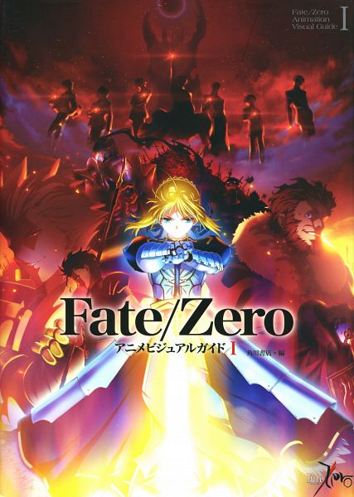
Fate/zero
Light novel written by Gen Urobuchi
  2006 C71: Vol 1
  2007 Mar: Vol 2
  2007 Jul: Vol 3
  2007 C73: Vol 4
Story of the 4th Holy Grail War, 10 years prior to Fate/stay night
2011-2012: Anime adaptation by ufotable
Notes:
Fate/zero tells the story of the 4th Holy Grail War, the grail war that happened 10 years prior to the one in Fate/stay night
Unlike F/SN, F/Z is a light novel has a singular straightforward storyline that focuses on the fights and personalities that revolved around the Holy Grail War
It received a 25-episode anime adaptation in 2011 by ufotable, which once again brought Fate to mainstream anime

Slide 30
FATE/PROTOTYPE
Notes:
Now there’s one last Fate-related work with an anime adaptation that I’d like to talk about and that would be Fate/Prototype
There’s no opening nor interesting PV for this one, here’s a fan-made AMV in anime opening style instead

Slide 31
Fate/prototype
12-minute OVA by Lerche in 2011
Nasu’s original Fate storyline, taking place 8 years after 4th Holy Grail War
Female Ayaka Sajyou with male Saber
Notes:
Fate/prototype is an OVA produced by Studio Lerche in 2011 to celebrate TYPE-MOON’s 10’th anniversary
It’s actually only 12 minutes long, so you’ve already seen a good chunk of it just from that AMV
Fate/prototype reflects the original Fate storyline that Nasu drafted back in highschool before he and Takeuchi went on to make Fate/stay night
Fate was not originally meant to be an 18+ game, and thus, Ayaka Sajyou, the main character in the original Fate story, was female, and her servant Saber was male

Slide 32

WITCH ON THE HOLY NIGHT
Notes:
Now enough with Fate, lets move on to the newest TYPE-MOON series, Witch on the Holy Night, also better known by its Japanese name, Mahou Tsukai no Yoru, shortened by fans to Mahouyo
Mahouyo hasn’t gotten any anime adaptation yet nor a ufotable opening animation treatment yet, so here’s a short TV commercial instead:

Slide 33

Mahou Tsukai no Yoru
All-ages visual novel
  2008 Apr: Announcement
  2009 Aug: Delayed til 2010
  2010 Sept: Delayed til 2011
  2011 Dec: Trial Edition
  2012 Jan Trial Edition 2
  2012 Apr: First Press Edition
  2012 Aug:Regular Edition
Originally written in 1996 but never published til 2012
Notes:
Mahouyo is TYPE-MOON’s first visual novel in a long, long time, mainly because the Fate series literally prints money
In fact, Mahouyo’s release date ended up being pushed back multiple times due to TYPE-MOON’s continually busy involvement with the various Fate games and adaptations
Ironically, Mahouyo was one of Nasu’s very first works, having being written in 1996 but never ended up being publishing til 2012

Slide 34
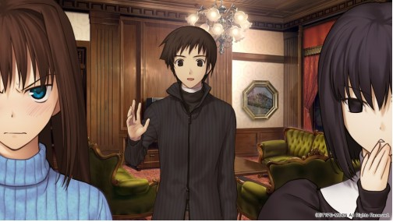
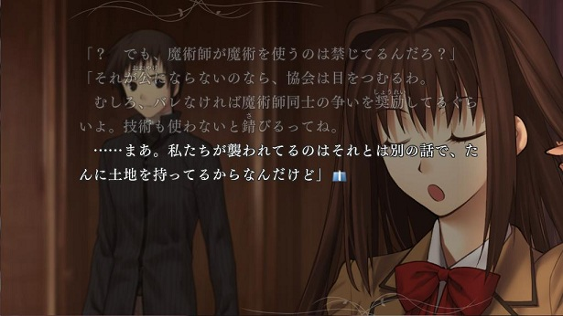
Mahou Tsukai no Yoru
Story of Aoko Aozaki, a highschooler, Alice Kuonji, a young witch, and Soujurou Shizuki, a classmate from the rurals, living together in a mansion
Linear plot line: no choices, only text
2 sequels planned for future
Notes:
Mahouyo tells of the story of Aoko, the protagonist, Alice, her witch roommate, and Soujurou, her highschool classmate, living together on a mansion on top of a hill
Unlike most visual novels, Mahouyo has a completely linear plot line. This means there are no routes nor choices, only walls of text and the occasional CG artwork

Slide 35
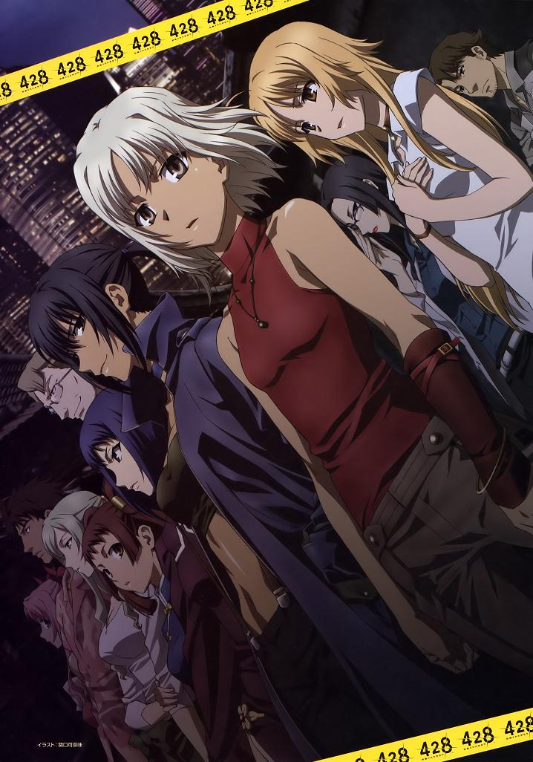
CANAAN
Notes:
Now that we’re done with TYPE-MOON’s main works, lets take a look at some animated side works related to the company, starting with one of my favourites, the action-packed anime CANAAN
Here’s the opening for the anime:

Slide 36


CANAAN
2009 action anime by P.A. Works
Sequel of Nasu-written scenario in Wii visual novel, 428: Fusa Sarate Shibuya de
Story of Canaan, a skilled assassin and mercenary, and Alphard, her rival of her past and head of terrorist organization
Notes:
Canaan is a 13-episde anime animated by P.A. Works that aired 2009
Canaan tells the story of the armed interventions and history between Canaan, a skilled assassin and mercenary, and Alphard, a rival of her past and also head of a terrorist organization

Slide 37

WORLD CONQUEST
~ZVEZDA PLOT~
Notes:
On a lighter note, not all of TYPE-MOON’s works are so serious, with World Conquest Zvezda Plot being one of them
Here’s the OP of the anime series

Slide 38

World Conquest ~Zvezda Plot~
2014 action-comedy anime by A-1 Pictures
Co-written by Meteor Hoshizora
Story of Kate Hoshimiya, a young looking little girl who leads the secret Zveda organization to achieve world domination
Notes:
Zvezda Plot is a 12-episde anime animated by A-1 Pictures that aired in 2014
Zvezda Plot tells the story of Kate Hoshimiya, a young-looking little girl who is also the leader of a secret military organization fighting against the Japanese government and planning to take over the world

Slide 39

FATE/KALEIDER LINER PRISMA☆ILLYA
Notes:
And hey, look, we’re back to Fate, with the Fate spin-off, Fate/Kaleider Liner Prisma Illya
Here’s the first OP of the anime series by studio Silver Link

Slide 40


Prisma☆Illya
Ongoing mahou shoujo manga
  2007: Prisma Illya
  2009: Prisma Illya 2wei!
  2012: Prisma Illya 3rei!!
Spin-off featuring Fate characters with the concept, “What if Illya was a magical girl?”
Anime adaptation by Silver link
  2013: Prisma Illya (10 ep + OVA)
  2014: Prisma Illya 2wei! (10 ep + OVA)
  2015: Prisma Illya 2wei Herz (TBA)
Notes:
Unlike the past few works I showed you, Prisma Illya actually started off as a manga before being adapted to anime form
Prisma Illya is a non-canon spin-off of the Fate series in a alternate universe with the concept, “What if Illyasviel von Einzbern was actually a cute magical girl?”
The result is ridiculousness, with self-referencing and slapstick comedy and blatantly obvious parodying of the mahout shoujo genre
There are currently 3 manga series for Prisma Illya, the original and half of the Twei beening animated so far, with the second half of 2wei’s anime adaptation expected to air later this year

Slide 41
CARNIVAL PHANTASM
Notes:
And last but not least, my favourite TYPE-MOON anime of all time, Carnival Phantasm
Here’s the opening of the anime by studio Lerche

Slide 42


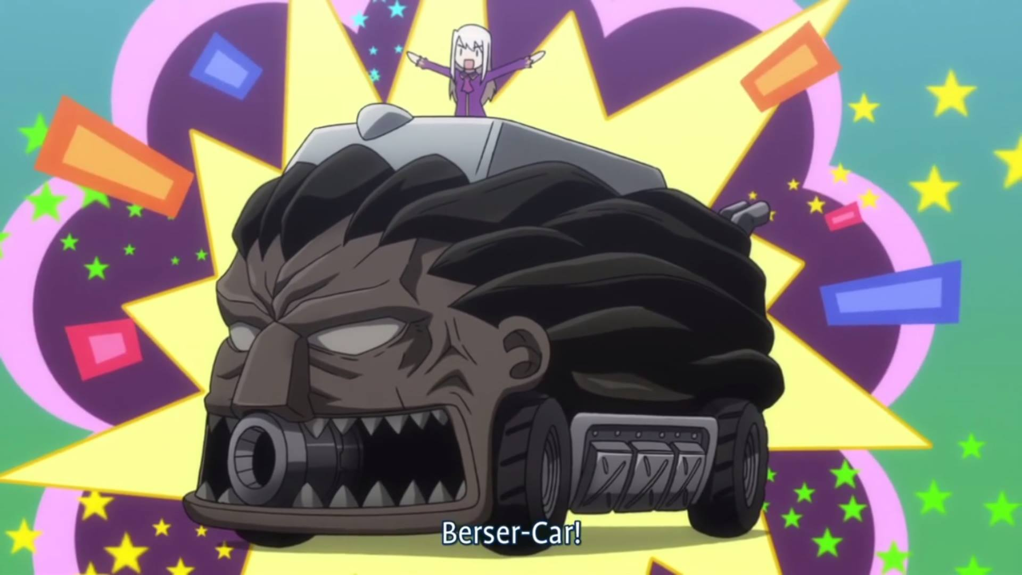
Carnival Phantasm
2011 comedy anime by Lerche
Adapted from Take-Moon gag manga
Gag stories and situations featuring various characters from TYPE-MOON works
Notes:
Carnival Phantasm is a 12-episde OVA series animated by studio Lerche in 2011 to celebrate TYPE-MOON’s upcoming 10th anniversary
A good portion of the series was adapted from the TYPE-MOON gag manga, TAKE-MOON
The series consists of non-stop gag stories and comical situations featuring various characters from TYPE-MOON works and is pretty much pure fanservice for TYPE-MOON fans. I highly, highly recommend you check it out after playing all the visual novels, at least Fate/stay night and Tsukihime

Slide 43

FATE/GAMES
Notes:
And that’s it for the list of TYPE-MOON main works or ones with anime adaptations
Apart from visual novels and animes, there’s also a long list of games that TYPE-MOON has been involved in, almost all of them relating to the Fate series
Here is a short list of some of them:

Slide 44

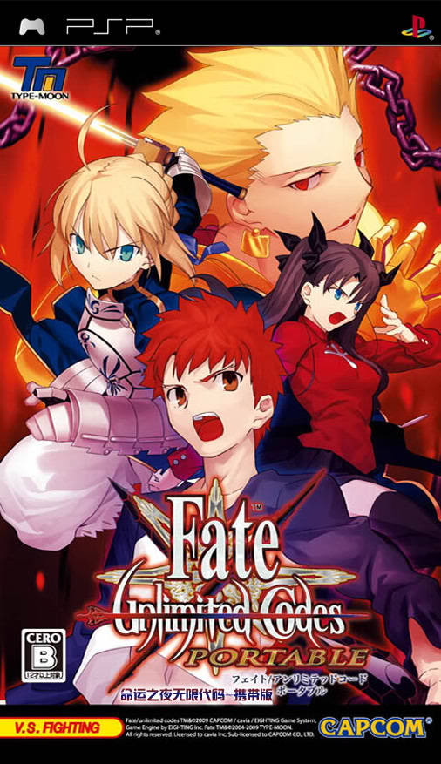
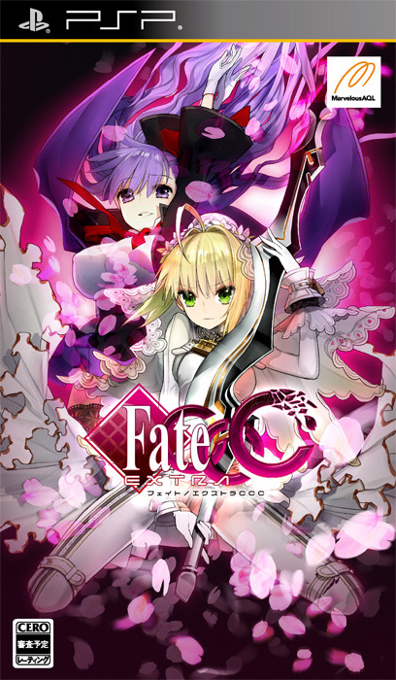
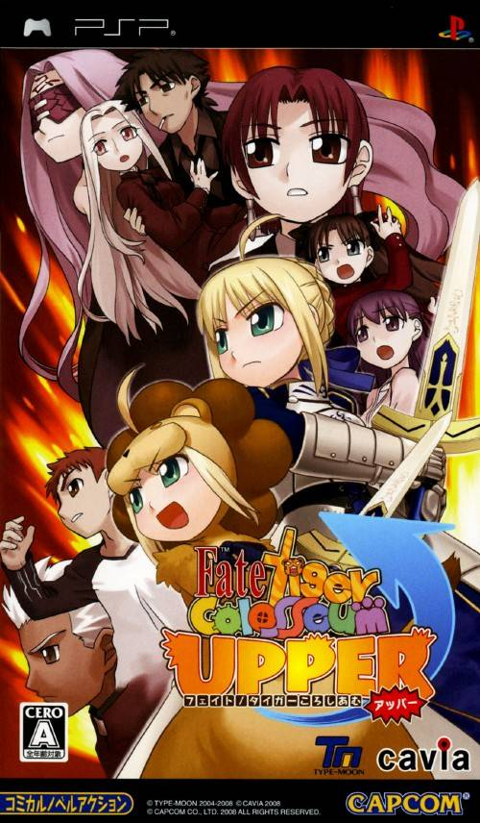
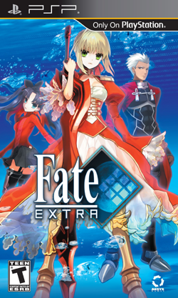
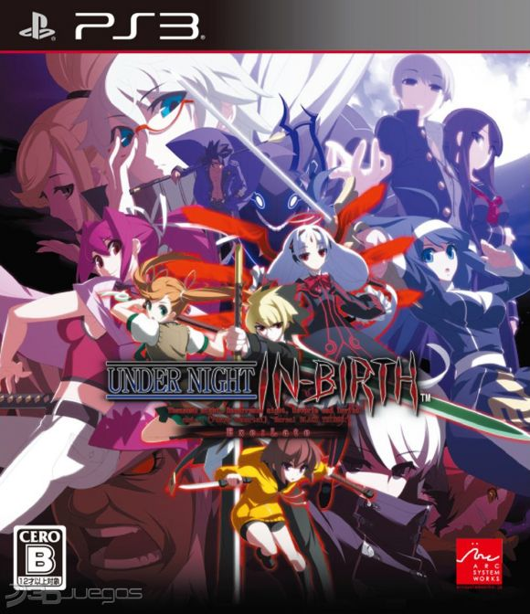
Notes:
Fate/tiger colosseum – 3D fighting game released by Capcom in 2007 for PSP, featuring chibified versions of Fate/stay night and Fate/hollow ataraxia characters
Fate/tiger colosseum Upper – sequel released in 2008, featuring more characters and additional comical outfits
Fate/unlimited codes – Fighting game released by Capcom in 2008 for PS2, PSP and arcade, featuring Fate/stay night characters
Fate/Extra – Dungeon crawler RPG released by Marvelous Entertainment in 2010 for PSP, featuring new alternate universe Fate characters and gameplay that is essentially glorified rock-paper scissors
Fate/Extra CCC – sequel to Fate/Extra released in 2013, featuring pretty much the same gameplay except with more revealing outfits for the female cast
There is also an upcoming mobile game called Fate/Grand Order featuring some new alternate Fate universe characters, but not much information has been announced yet for it, let alone any gameplay videos
Due to TYPE-MOON being so busy with all these Fate games, there’s been no time for a new Melty Blood, so Ecole Software instead released Actress Again’s spiritual successor, Under Night In Birth, which includes Melty Blood’s Sion as one of the playable characters

Slide 45

TYPE-MOON BOOKS
Notes:
In addition to collaborating with other companies to make Fate-series games, TYPE-MOON also publishes a lot of light novels, many of which are not written by Nasu
Here’s a partial list – you can check out the full list on TYPE-MOON’s own website

Slide 46




Notes:
DDD (Decoration Disorder Disconnection) – 2007 novel about a world where demonic possessions and supernatural powers are commonplace
Fate/strange fake – 2009 novel about an alternate future after the 3rd Holy Grail War
Tsuki no Sango – 2010 short story about a world 3000 years in the future where civilization is slowly losing it’s will to continue
Fire Girls – 2012 novel about the adventures of members of the Exploration Club in a fantasy world
Fate/Apocrypha – 2012 novel about an alternate future after the 3rd Holy Grail War featuring 14 Servants instead of 7

Slide 47

Looking for more?
Tsuki-kan:
http://tsukikan.com
http://tmdict.com
TYPE-MOON Wikia:
http://typemoon.wikia.com
http://typemoon.wikia.com/wiki/List_of_TYPE-MOON_media
TV-Tropes:
http://tvtropes.org/pmwiki/pmwiki.php/Franchise/Nasuverse
Beast’s Lair Forums:
http://forums.nrvnqsr.com
More links at http://keripo.com/type-moon
Notes:
Keep in mind that what you have seen today only covers the main works by TYPE-MOON – there are tons more TYPE-MOON related stuff out there
But instead of listening to me rant about them for hours on end, you can look them up and explore online
Tsuki-kan is my favourite TYPE-MOON fan website, containing a comprehensive database of TYPE-MOON works with tons of detailed information and translated interviews with Nasu and Takeuchi
There’s also the TYPE-MOON wikia, which, like Wikipedia, you can easily spend hours in, clicking links and reading about the million different characters and mechanics of the Nasuverse
TV Tropes actually has a pretty detailed TYPE-MOON section and explains a lot of references and memes, though be wary of spoilers
And last but not least, there’s the Beast’s Lair forums, the largest English-speaking online forums frequented by TYPE-MOON fans and trolls alike
If those aren’t enough, I also have a good list of links on the TYPE-MOON section of my website, keripo.com/type-moon

Slide 48
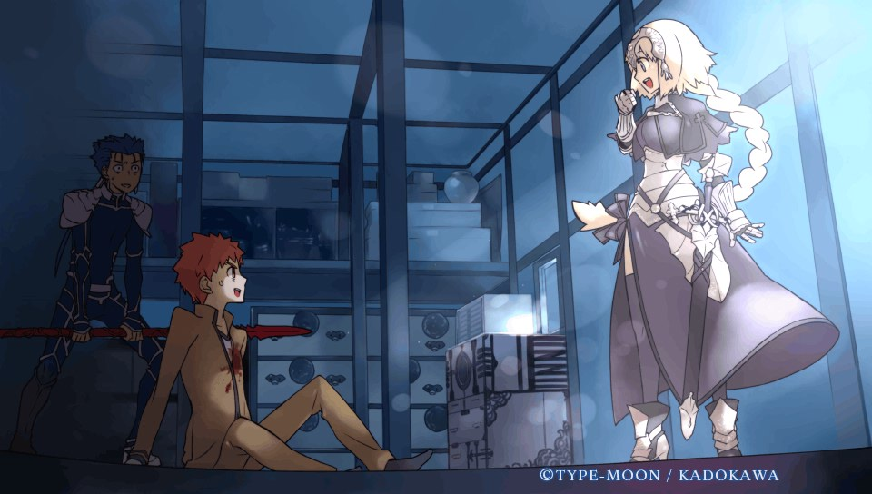
THE END!
Questions?
Keripo (Philip Peng)
Email: k.darktiger@gmail.com
Website: http://keripo.com
Facebook: http://facebook.com/keriposcorner
Notes:
And that concludes today’s panel
If you have any questions, now’s the time to ask (or if I don’t get to you, here’s my contact info)
Again, these slides and a full audio recording will be posted on my website so make sure to check it out later.

