Slide 1



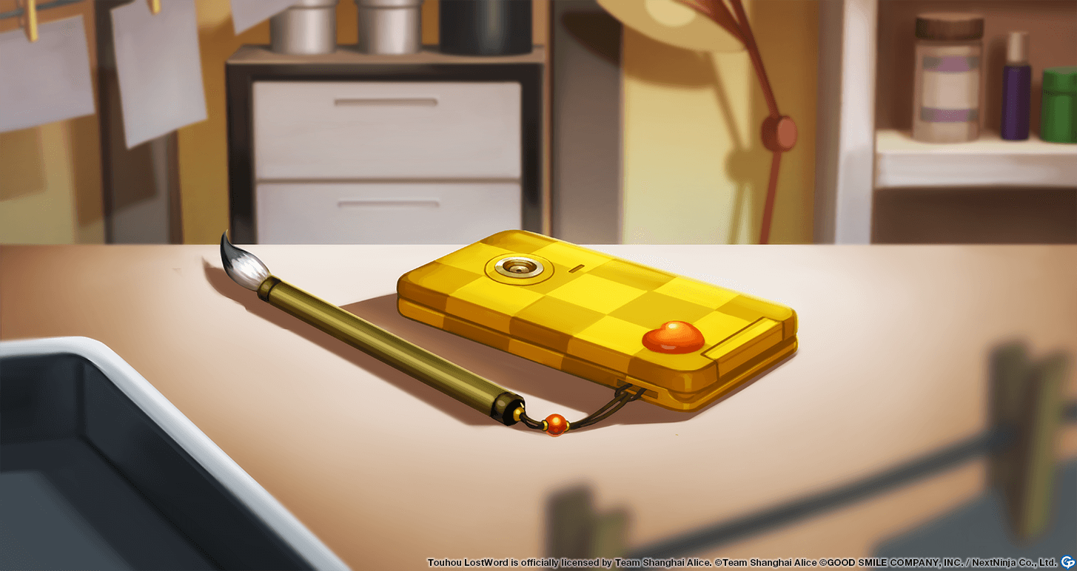



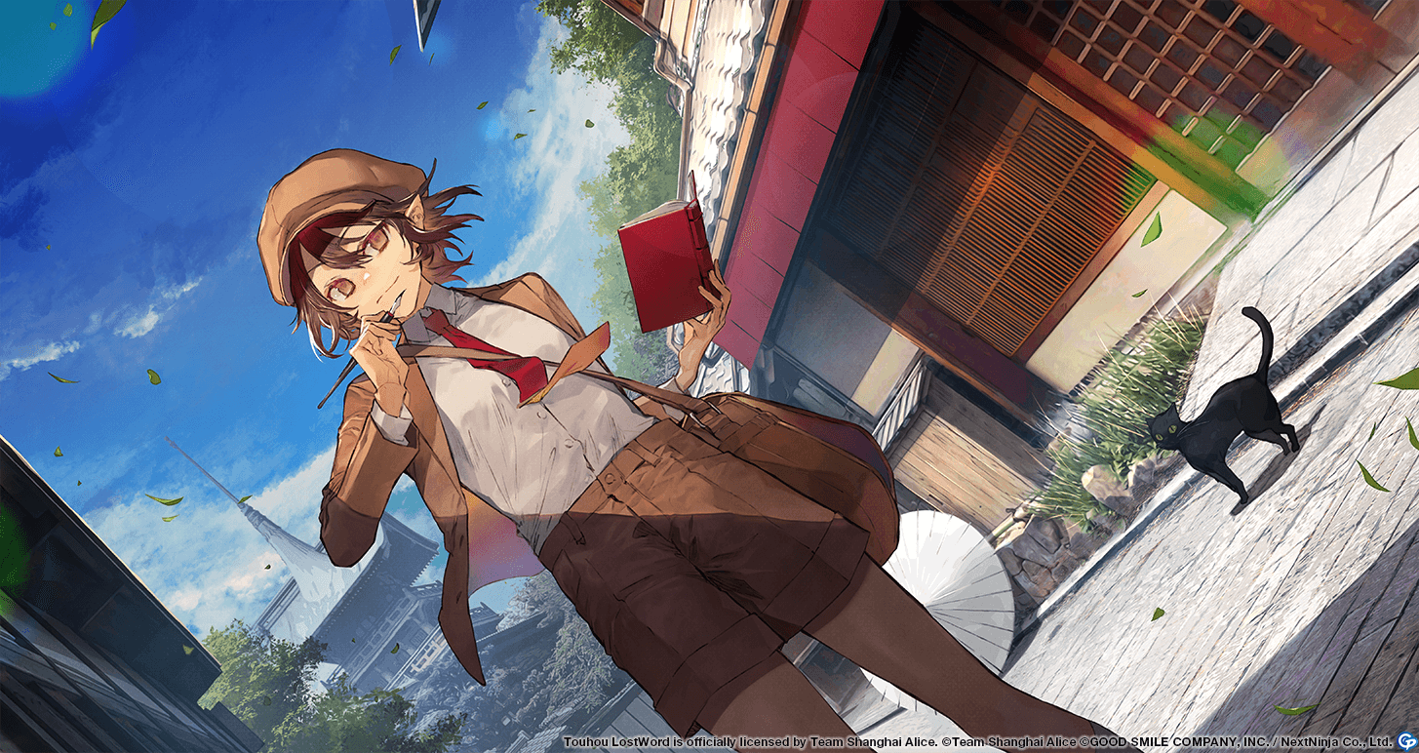



























TLW Global – Last Word Story Card Recommendations (V4)
Recommendations are for the common scenario of solo-farming 1-wave stages under the assumption of lvl 10 character skills and +10 refined MLB story cards. For other setups, consult the Story Card Guide or ask in Discord. Note that these recommendations will continually change as new story cards are introduced. Also note that not all units are good for solo-farming – see GamePress’ tier list.
Do not MLB Marisa!
Marisa’s main purpose is to wave clear with her All-target spell cards. But her Last Word is single target, which will screw up auto runs.
+3 Accuracy
+3 Accuracy
Non-damaging LastWord
+3 Accuracy
+3 Accuracy
+30% Wood
+25% Body
+3 Yang
+25% Laser
+3 Accuracy
+3 Accuracy
+20% Liquid
+2 Accuracy
+3 Accuracy
+3 Yang
+25% Laser
+3 Yang
+10% Water
+3 Accuracy
+3 Accuracy
+3 Accuracy
+3 Accuracy
+3 Accuracy
+3 Accuracy
+3 Yin
+15% Wood
+3 Yin
+25% Ofuda
+20% Liquid
+2 Accuracy
+3 Accuracy
+3 Accuracy
+3 Accuracy
+3 Yin
+15% Wood
+3 Yin
+25% Ofuda
+3 Accuracy
+3 Accuracy
+3 Accuracy
+3 Accuracy
+3 Accuracy
+3 Accuracy
+3 Yin
+15% Wood
+3 Yin
+25% Ofuda
+3 Accuracy
+3 Accuracy
+3 Accuracy
+3 Accuracy
+3 Accuracy
+3 Accuracy
+3 Accuracy
+3 Accuracy
+3 Yang
+25% Laser
+3 Yang
+10% Water
+3 Accuracy
+3 Accuracy
+3 Accuracy
+3 Accuracy
+3 Accuracy
+3 Accuracy
Last updated: 2021/06/23
Created by Keripo for Touhou Lost Word (Global)
See #questions-and-advice in Discord for the latest versions
For more details, see https://gamepress.gg/lostword/list/touhou-lostword-tier-list

